Slide 1
General Contract of Use (GCU)
IGTL workshop
Gilles PETERHANS
Secretary General
October 17, 2018, Warsaw

Slide 2
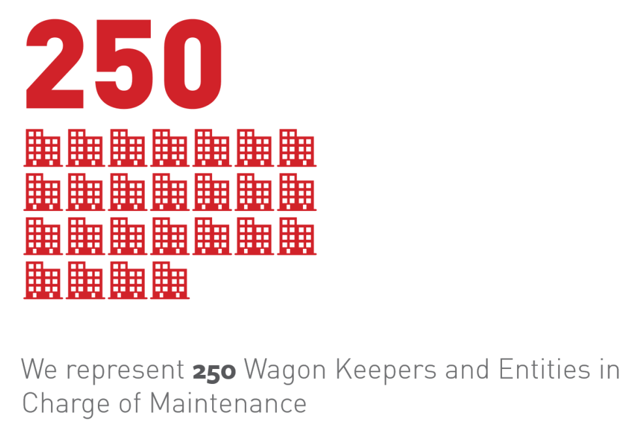
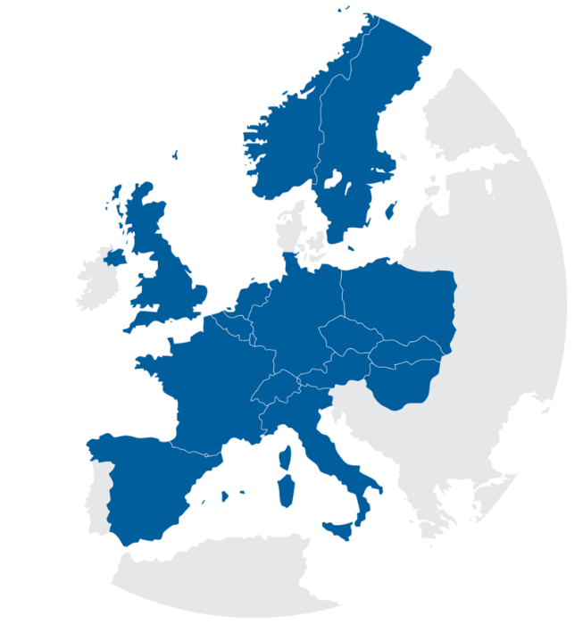
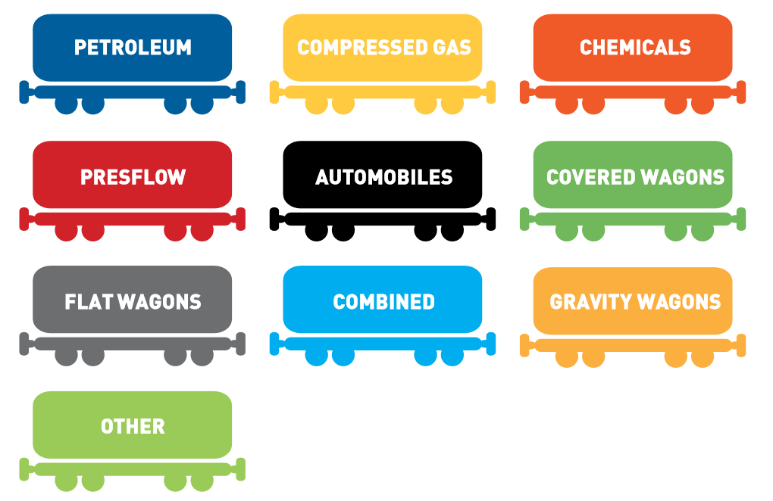
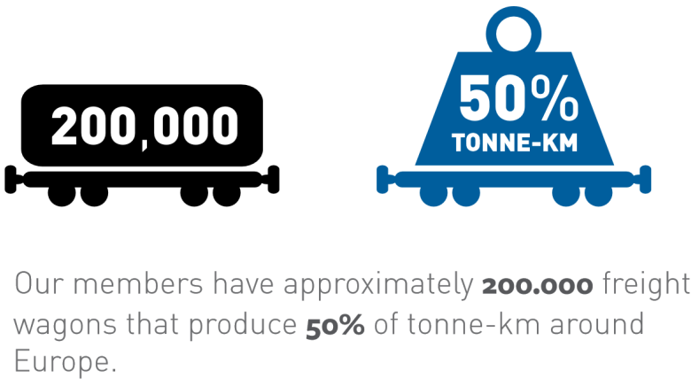
UIP – International Union of Wagon Keepers
14 National Associations

Slide 3



Results fleet data collection 2017 – wagon types
UIP – approx. 205’000 freight wagons out of 210’000

Slide 4
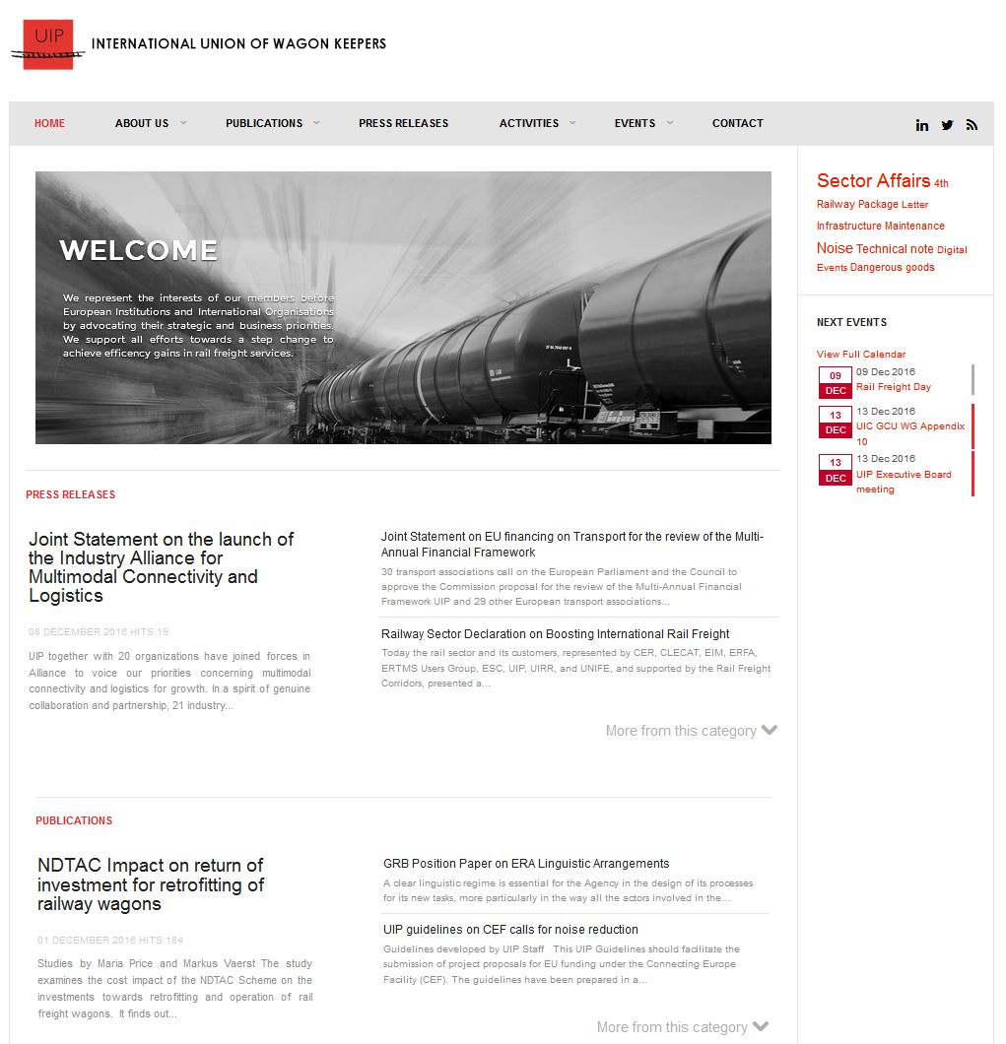

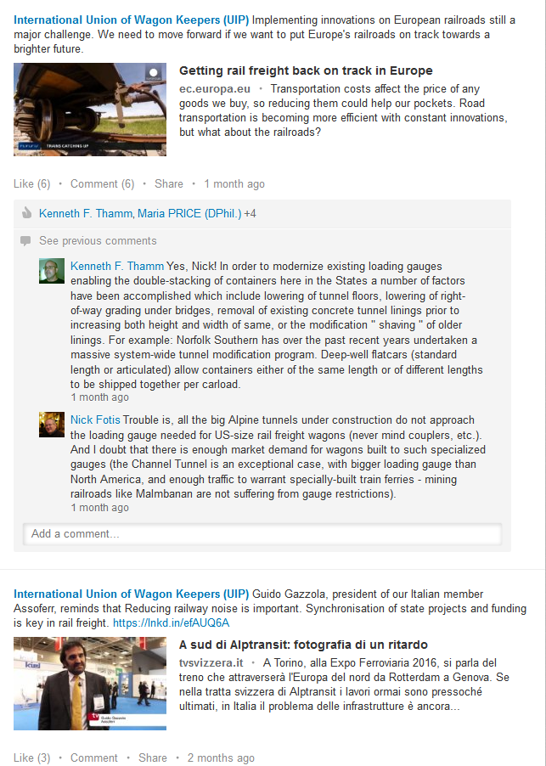
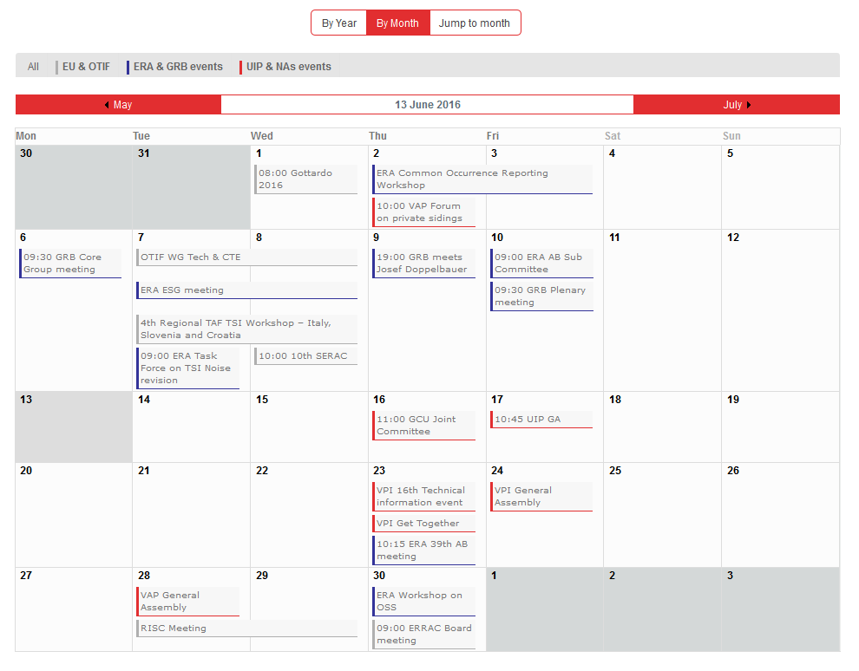
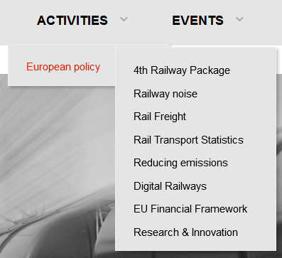

UIP – stay informed
Twitter
Linkedin

Slide 5
GCU legal framework
What is legal base for the General Contract of Use (GCU) ?
  Entering into force of COTIF 1999 on 1 July 2006
  New right of use for wagons – Appendix D, CUV
  Requires contract between RUs and wagon keepers for wagon use; Art. 1 CUV
  Allows broad scope for contract design for wagon use, in particular broad derogations => “Unless the contracting parties otherwise agree,...” (e.g. Art. 9 § 2 CUV)
COTIF 1999
OTIF Technical Admission
Technical
Prescriptions
Admission
Procedure
Appendix А
Appendix B
Appendix C
Appendix D
Appendix E
Appendix F
Appendix G
UR CIV
UR CIM
RID
UR CUV
UR CUI
UR APTU
UR ATMF
Uniform Rules
concerning
the Contract
of International
Carriage
of Passengers
by Rail
Uniform Rules
concerning
the Contract
of International
Carriage
of Goods
by Rail
Regulation concerning
the International Carriage
of Dangerous Goods
By Rail
Uniform Rules
concerning
Contracts of Use
of Vehicles
in International
Rail Traffic
Uniform Rules
concerning
the Contracts
of Use
of Infrastructure
in International
Rail Traffic
Uniform Rules
concerning
the Validation
of Technical
Standards and
Adoption of
Uniform Technical
Prescriptions
applicable to
Railway Material
intended
to be used
in International
Traffic
Uniform Rules
concerning
the Technical
Admission of
Railway Material
used
in International
Traffic
GCU
TSI
ECM

Slide 6
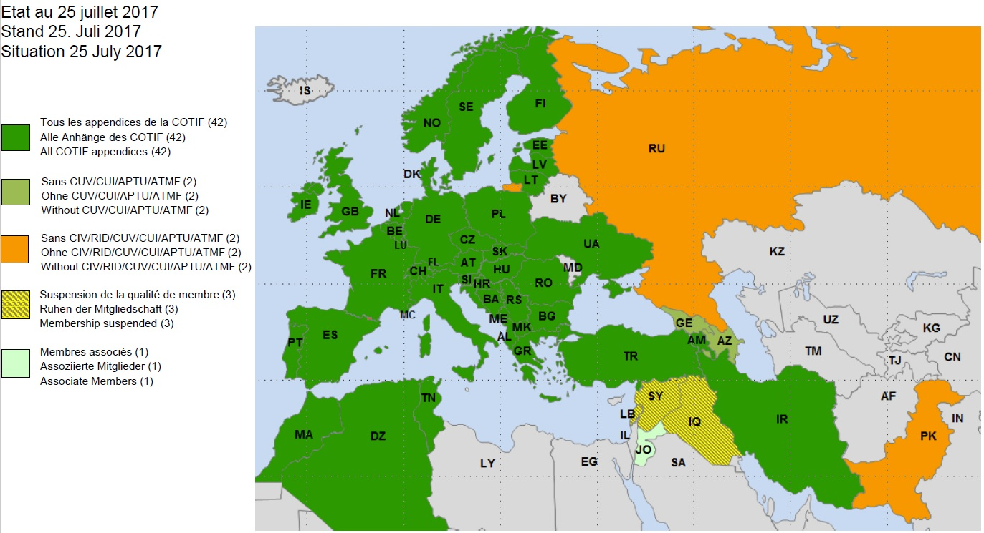
GCU legal framework
Geographical scope of application of COTIF and its appendices

Slide 7
The General Contract of Use (GCU)
COTIF Appendix D (CUV): legal relation between the keeper (responsible for the wagon) and the RU (using the wagon) but
Requires a multitude of bilateral contracts
No regulation on the assessment and handling of damages
No regulation on the rights and obligations of the parties
GCU supplements CUV with detailed regulation and creates a uniform contractual situation with minimum standards
GCU is a key element and a cornerstone for safe, efficient and reliable rail freight traffic

Slide 8



GCU: structure & decisions
GCU office
(1 Trustee)
Joint Committee
UIC / UIP / ERFA
(5+5+2 Votes)
Amendment porposal must be unanimously supported
Every amendment proposal needs a “3/4 majority” in the 3 groups of signatories
Amendment proposal must be supported by at least 25 contracting parties/signatories
WG
Appendix 10
UIC/UIP/ERFA
675 GCU contracting parties (06.2018)
WG
Appendix 9/11
UIC/UIP/ERFA
235 RUs:
¾ votes &
¾ of represented tkm
146 RU & Keeper:
¾ votes &
¾ of the registered wagons
294 Keepers:
¾ votes &
¾ of the wagons
Unanimous vote by the signatories/contracting parties: Changes enter into force according proposal or 3 months after positive vote
Majority vote: Changes enter into force 6 Months after positive vote
Notes:
8

Slide 9
Actual scope – GCU message broker project
  Scope
  The message broker as the only one IT interface between the RU and keeper
    Signatories exchange mileage events (new App. 15)
    Signatories exchange wagon damage reports (WDR) (updated App. 14)
    Signatories exchange technical information of the wagon on request (new App. 16)
    Signatories exchange actual operational restrictions of the wagon on request
    Signatories exchange the codes of intervention
    (Appendix 10, Annex 6)
    To be defined (e.g. bills, technical instructions, completion of repairs (article 19.4))
  TAF requirements are considered
1st design & development

Slide 10





Operating principles I – GCU Message Broker
Technical communication via Common Interface (TAF TSI)
Operational data
e.g. mileage, damage report (Annex 4) & operational
restrictions discovered by the RU)
technical data & temporary operational restrictions
from RU or ECM
(e.g. temporary speed limit)
Message Broker
  Data of Wg# and IP address
  keeper
  RSRD with min. TAF TSI Data
  RU
  Operational Data (e.g. damage code)
  Mileage for RailData members

Slide 11
General Contract of Use
The 2019 GCU: 2 new amendments
New Appendix 15: Appendix 15 describes in more detail the information-related requirements laid out in article 15. In accordance with pages 3-4, the user RU must send the Wagon Performance Message to the wagon keeper for all wagons registered in the GCU database.
New Appendix 16: Appendix 16 describes in more detail the information-related requirements laid out in article 7.4. In accordance with pages 5-8, the keeper must provide the administrative and technical vehicle data for all wagons registered in the GCU database as soon as possible prior to the use of a wagon. The RU has access to this data at all times and may use it for its own operational purposes only.

Slide 12
GCU – Article 18: Ascertainment of damage
18.1 When damage to a wagon or the loss or damage of the removable accessories mentioned on the wagon are discovered or presumed by an RU or the keeper claims they exist, the RU shall without delay and, if possible, in the keeper's presence, draw up a wagon damage report (as per Appendix 4) documenting the nature of the damage or loss and, insofar as possible, the cause and the time it took place.
18.2 When the damage or loss of parts does not prevent use of the wagon in traffic, the keeper does not need to be invited when the damage or loss is recorded.
18.3 A copy of the wagon damage report shall be sent to the keeper without delay.
18.4 If the keeper does not accept the contents of the wagon damage report, he may ask for the nature, cause and extent of damage to be recorded by an expert appointed by the parties to the contract or by judicial means. This procedure shall be subject to the law of the country in which it takes place.
18.5 When a wagon sustains damage or loss of a part and is unable to run or be used
as a result, the RU shall also inform the keeper immediately, providing the following information as a minimum:
the wagon number
the status of the wagon (loaded or empty)
the date and place it was withdrawn from service
reason for withdrawal from service
details of the department to contact
probable duration of wagon unavailability (up to 6 working days; more than 6 working days).

Slide 13
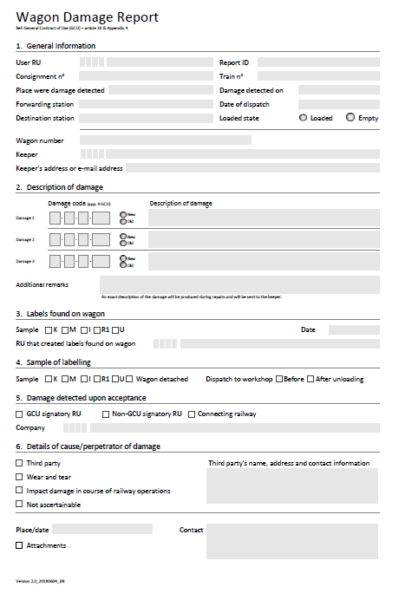
GCU – Article 18: Ascertainment of damage
Art. 18 anchors within the GCU the essential and important flow of information from the RU to the keeper
=> Core element of satisfying the ECM obligations
Standardised procedure for the information flow via reference to Appendix 4 GCU
Appendix 4 is mandatory: RU has to send an electronical WDR to the wagon keeper for all wagons registered in the GCU database!

Slide 14
GCU – Article 19: Handling of damage
New amendments valid from 01.07.2019
19.5 In cases where the RU carries out measures in application of the provisions of Appendix 9, it shall do so with qualified staff and all due care. In the context of the preceding provision, “qualified staff” (operations staff) means staff possessing the competences and authorisations to take corrective measures, described in the RU’s safety management system (SMS). Repair work in application of the provisions of Appendix 10 may only be performed by approved workshops.
Approved workshops are:
Workshops which have a valid certificate for an entity in charge of maintenance (ECM certificate) containing the maintenance delivery function as a minimum, and
are listed in the European Railway Agency Database of Interoperability and Safety (ERADIS) and
which are conversant with Appendices 7, 9, 10 and 13 to the GCU and instruct their employees on changes to the GCU on a regular basis.
The RU or his auxiliary must inform the keeper of the work performed, using the codes provided in Appendix 10, Annex 6.
Clarification of the wording “approved workshops”, remains to be seen how it works in practice (UIP asked for a delay for the introduction in order for smaller workshops doing “on track repairs” to be able to get certified

Slide 15
GCU – Article 19: Handling of damage
New amendments valid from 01.07.2019
Background for amendments: compliance of “approved workshops” as term used in GCU framework with ECM regulation. The adjustments to Article 19 containing the new definition of “approved” workshops ensure there is legal certainty between the GCU partners when commissioning and performing maintenance/repair work in the context of Appendix 10. Both RUs and keepers can thus meet their legal and contractual obligations.
19.4 The RU that initiated the maintenance in accordance with Appendix 10 shall check whether and to what extent the work requested has been completed on the basis of information received from the workshop. Any restrictions on use (e.g. fitness to run, fitness for service) that become apparent after the repairs must be documented by the RU.
On completion of the repairs and failing any specific instructions from the keeper, the RU shall forward the wagon to the destination station for which it was initially bound.
Clarification the obligations of the RU for the parts of the fleet maintenance management function (ECM III function) performed when maintenance works based on Appendix 10 GCU have been commissioned by the user RU
Wagon remains in the custody of the RU during the “en route repair”!

Slide 16
GCU – Article 34: Languages
The present contract exists in English, German and French; each language version has the
same contractual value.
Two GCU members with different national languages must carry out their correspondence
in one of the official GCU languages. The fields in the form in Appendix 4 must thus
be written in at least one of those three languages. Invoices may be issued in
the national language of the place of issue. The provisions of Annex 6 of Appendix 10 (coding of
interventions) remain unaffected.
New provision since 2014 to simplify communication
GCU Joint Committee readily prepared to publish other language versions on its website similar to what’s done by the OTIF (http://otif.org/en/?page_id=172 -> Farsi and Russian version)
GCU trustee/Joint Committee will not handle any request for translation

Slide 17













Thank you for your attention!
Austria
Belgium
Czech
Republic
France
Germany
UK
Hungary
NVPG
Italy
Netherlands
Poland
Slovak
Republic
Spain
Sweden
Switzerland
GILLES PETERHANS
Secretary General
gilles.peterhans@uiprail.org

