Slide 1
IGTL - GCU Workshop 24.10.2017, Warszawa Markus Vaerst Vice-President ERFA Rapporteur GCU Joint Committee

Slide 2
Legal relationships
GCU closes the gap with regard to contractual relationship between Keepers and RUs
GCU is in many cases the only contractual relationship between these two parties
GCU sets common provisions for rail freight traffic
ECM =
Keeper
Rental
Contract
Customer / Lessee
Consignment
Note
RU (1)
IM
Track access / CUI
Contract
Sub contarct
GCU
RU
(2 -n)
Track access / CUI
Workshop

Slide 3
GCU – Structure & Bodies
GCU Office
(1 Trustee)
Joint Committee
UIC / UIP / ERFA
(5+5+2 votes)
Amendment proposal needs unanimous support
Each amendment proposal needs ¾-Majority in each of the three groups
Amendment proposal needs at leats support from 25 signatories
WP
Appendix 10
UIC/UIP/ERFA
664 Signatories (08.2017)
217 RUs:
¾ of votes AND
¾ of tkm
153 RUs and Keepers:
¾ of votes AND
¾ of wagons
297 Keepers:
¾ of votes AND
¾ of wagons
WP
Appendices 9 & 11
UIC/UIP/ERFA
Unanimous approval:
Entry into force according proposal (most cases: 1st January)
Or 3 months after adoption
Qualified majority: Entry into force 6 months after adoption
Notes:
3

Slide 4
GCU – Figures
664 GCU Signatories & approx. 580´000 Wagons (08.2017)
EVU | 217
Austria | 14
Belgium | 3
Bulgaria | 2
Croatia | 3
Czech Republic | 8
Denmark | 1
Finland | 1
France | 13
Germany | 83
Greece | 1
Hungary | 7
Italy | 20
Netherlands | 13
Poland | 14
Romania | 5
Slovakia | 10
Slovenia | 1
Spain | 2
Sweden | 5
Switzerland | 9
United Kingdom | 2
EVU und Halter | 153
Austria | 4
Belgium | 2
Bosnia and Herzegovina | 2
Bulgaria | 5
Croatia | 1
Czech Republic | 18
Denmark | 1
France | 4
Germany | 48
Hungary | 9
Italy | 2
Lithuania | 1
Luxembourg | 1
Macedonia | 1
Montenegro | 1
Netherlands | 1
Norway | 2
Poland | 19
Romania | 10
Serbia | 2
Slovakia | 5
Slovenia | 1
Spain | 1
Sweden | 4
Switzerland | 5
Turkey | 1
United Kingdom | 2
Halter | 294
Austria | 17
Belgium | 3
Czech Republic | 37
France | 39
Germany | 65
Hungary | 7
Italy | 11
Luxembourg | 1
Netherlands | 5
Norway | 1
Poland | 14
Romania | 4
Serbia | 1
Slovakia | 26
Slovenia | 2
Spain | 6
Sweden | 15
Switzerland | 36
Turkey | 2
United Kingdom | 2

Slide 5
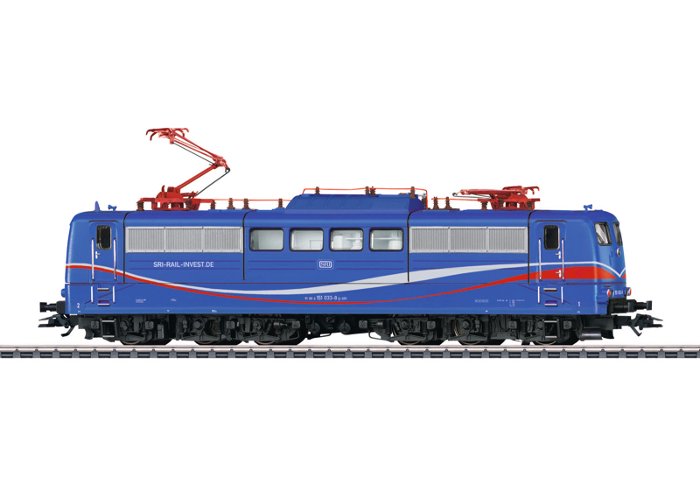
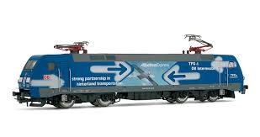
GCU – Articles 1.2 & 2.3
Article 1: Object
1.2 - The provisions of this contract shall apply to wagon keepers and RUs as users of wagons.
RU A
RU B
RU A accepts wagons from Keeper C
RU B accepts wagons from Keeper C handed over by RU A
Keeper C
Article 2: Scope of application
2.3 - The provisions of this multilateral contract shall apply between the signatories to the extent that they have not concluded other provisions between themselves.
Potential conflicts in case individual GTC are applied (in parallel to GCU)

Slide 6
GCU – Article 5: Discontinuance of being a signatory
If due amounts of more than 100 EUR owed by a signatory according to section I point 12 of Appendix 8 have been outstanding for more than six months and after an additional request for payment are not paid by the signatory within two months after the request has been sent, the discontinuance of its being a signatory shall be published in the monthly list according to article 2.4. From then on it shall be considered to be a third party according to articles 16 and 17.
Notwithstanding non-payments of the annual fee invoiced by th GCU Office, there is no basis to impose sanctions if provisions of the GCU are not / only partly / wrongly applied; legal measures have to be taken individually by the signatory.
Article 31: Obligation to pay damages (German: “Schadensersatz”)
“When a signatory fails by its own fault to meet an obligation which is due under this contract, he shall compensate the affected signatory for the direct damages suffered.“
“Ultima ratio”:
Article 9.4: “Any request from a keeper for his wagons not to be handed over to certain RUs, whether signatory or third party, shall be met.”

Slide 7
GCU – Article 32: Competent Jurisdiction
Unless otherwise agreed between the parties, the competent jurisdiction shall be that in
which the defendent is established.
In many cases: rather small amounts vs. costly and lenghty court cases
Could arbitration facilitate the process?
Appendix 8, II.5 (valid until 31st December 2017):
“The Joint Committee shall establish a permanent group of experts under its supervision with the following duties:
(…)
conducting arbitration at the joint request of the parties to a dispute.”
No longer foreseen as from 1st January 2018 – Considerations from the Joint Committee
Never used since 2006
Reimbursement of experts (travel cost, working time)
Possible way forward:
Concrete proposal (based on „best practices“ [e.g. UIC prpcedure, …)

Slide 8
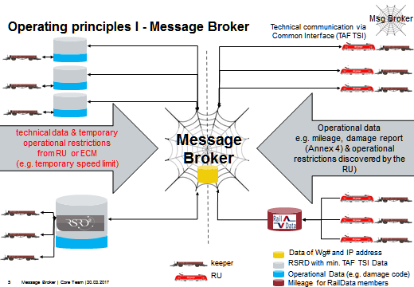
GCU – Article 18: Ascertainment of damage
18.1 When damage to a wagon or the loss or damage of the removable accessories mentioned on the wagon are discovered or presumed by an RU or the keeper claims they exist, the RU shall without delay and, if possible, in the keeper's presence, draw up a wagon damage report (as per Appendix 4) documenting the nature of the damage or loss and, insofar as possible, the cause and the time it took place.
18.2 When the damage or loss of parts does not prevent use of the wagon in traffic, the keeper does not need to be invited when the damage or loss is recorded.
18.3 A copy of the wagon damage report shall be sent to the keeper without delay.
(…)
No clear definition of „without delay“ – in legal terms it should be interpreted that the wagon damage report (WDR) should be send as quick as possible, „without undue delay“
Note 1: the WDR is initially established by the wagon inspector (pre-departure check, receiving a wagon from another RU) and needs to be processed internally by the RU – this may result in delays (but certainly not weeks or even months)
Note 2: an ad-hoc GCU Working Group currently discusses ways to speed up the process

Slide 9
GCU – Article 22: Liability of the user RU
22.1 The RU which has custody of a wagon shall be liable to the keeper for any loss of or damage to the wagon or accessories unless it proves that the damage was not caused by fault on its parts.
22.2 The RU shall not be liable if it brings proof of one of the following:
circumstances that the RU was not able to avoid and the consequences of which it could not prevent; [e.g. Force Majeur, however: challenging proof]
fault of a third party; [“third party” is not the “auxiliary person”, e.g. infrastructure manager”]
insufficient maintenance by the keeper when the RU can prove that the wagon was properly used and inspected [in this case the RU has to proof two facts];
fault of the keeper.[but: causal connection necessary]
If the RU is found to be partly responsible, the damage shall be borne by the responsible parties in proportion to their respective share of responsibility. The keeper cannot cite the existence of a hidden defect on his wagon as proof that there was no fault of his part.
The Keeper has to proof, that
a damage occured to his wagon,
the wagon was under the custody of the RU to whom he addresses the claim
The Keeper must NOT proof that the RU was at fault
Contractual reversal of burden of proof in favor of the Keeper (differing from „normal“ civil law provisions)

Slide 10
GCU – Article 22: Liability of the user RU
22.3 The RU shall not be liable for:
loss of or damage to removable accessories that is not listed on both sides of the wagon;
loss of and damage to removable tackles (filling hoses, tools, etc.),
provided that it cannot be shown to be at fault.
„Exemption of the exemption“ (Article 22.2): The Keeper has the burden of proof towards the RU

Slide 11
GCU – Article 23: Amount of compensation
(Version: 1st January 2018)
23.1 In case of loss of the wagon or its accessories, the amount of compensation shall be
calculated in accordance with Appendix 5.
23.2 In case of damage to the wagon or its accessories, compensation shall be limited to the cost of repairs. Compensation for loss of use shall be granted in accordance with Article 13.3 and compensation for the change in operational value for damaged wheelsets in accordance with Appendix 6, Part II. When a request is sent to the keeper for spare parts to carry out repair work, the period of loss of use shall be suspended between the date of the request and the date on which the parts are received. The total amount of Ccompensation (for loss of use and for reprofiling wheelsets) may not exceed the amount that would be payable for loss of the wagon.
Extract Appendix 6:
2.3 Flat-rate compensation to be paid for loss of use arising from repair work on the wagon
The RU responsible for the damaging a wagon or its accessories as per GCU Article 22, shall pay the keeper a flat rate of compensation upon presentation of an invoice (…) for each indivisible (calendar) day on which the wagon is unavailable for use. This compensation shall be calculated starting from the day following that on which the damage was first recorded (… [Appendix 4]) and shall end on the day on which the wagon's fitness for service is restored. The loss-of-use period shall be suspended in the following cases:
if the wagon is given a K label in the sense of GCU Appendix 9 and then takes more than two days to be taken to the workshop (a flat rate then applies for the time taken to reach the workshop);
if the wagon is given a K label (GCU Appendix 9) and transferred between two workshops and this takes more than two days (a flat rate then applies for the time taken to reach the other workshop);
from the day the damage was recorded up to the day the goods are unloaded if the wagon has been given a K label before being forwarded;
for the time elapsing between the request of spare parts as per Forms H and HR and the delivery of these parts (GCU Article 23.2);
if the wagon is taken for further maintenance work at the keeper’s behest.

Slide 12
GCU – Article 23: Amount of compensation
(Version: 1st January 2018)
23.1 In case of loss of the wagon or its accessories, the amount of compensation shall be
calculated in accordance with Appendix 5.
23.2 In case of damage to the wagon or its accessories, compensation shall be limited to the cost of repairs. Compensation for loss of use shall be granted in accordance with Article 13.3 and compensation for the change in operational value for damaged wheelsets in accordance with Appendix 6, Part II. When a request is sent to the keeper for spare parts to carry out repair work, the period of loss of use shall be suspended between the date of the request and the date on which the parts are received. The total amount of Ccompensation (for loss of use and for reprofiling wheelsets) may not exceed the amount that would be payable for loss of the wagon.
The provision „… and compensation for the change in operational value for damaged wheelsets in accordance with Appendix 6, Part II” enters into force on January 1st 2018.
Extract Appendix 6:
II. COMPENSATION FOR REPROFILING OF WHEELSETS
The RU responsible for damaging the wheelsets to be reprofiled shall pay the keeper upon presentation of an invoice with supporting documents a flat rate of 350 EUR for the loss of value arising as a result of reprofiling (reduction in the running-circle diameter).

